Slide 1
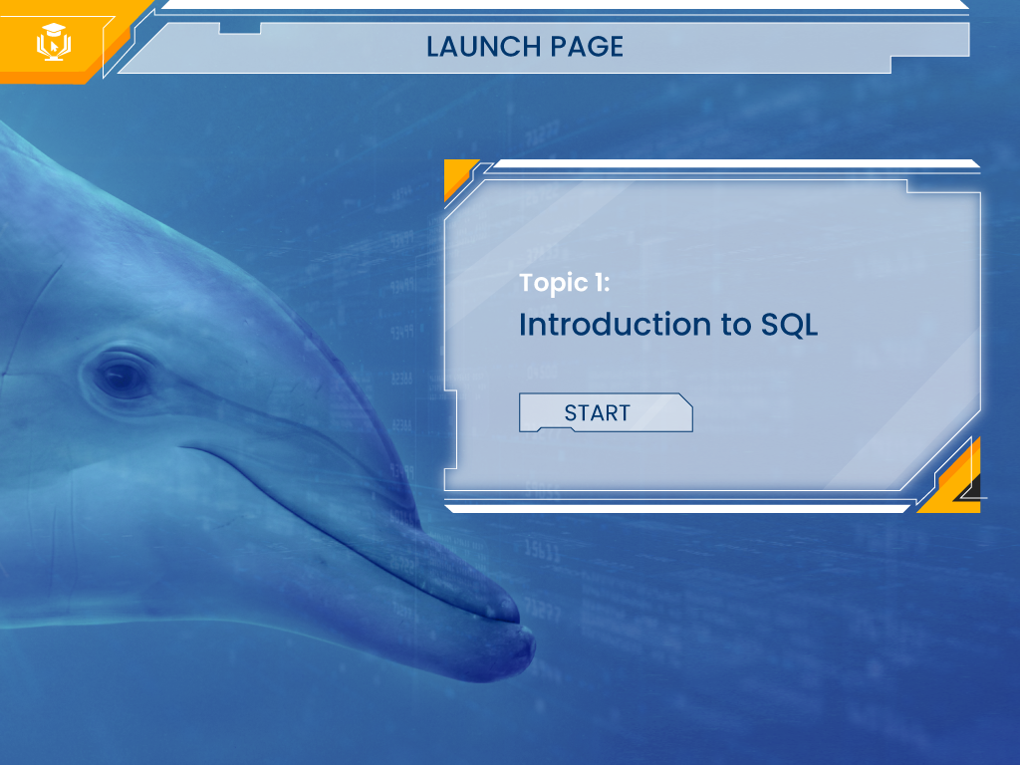
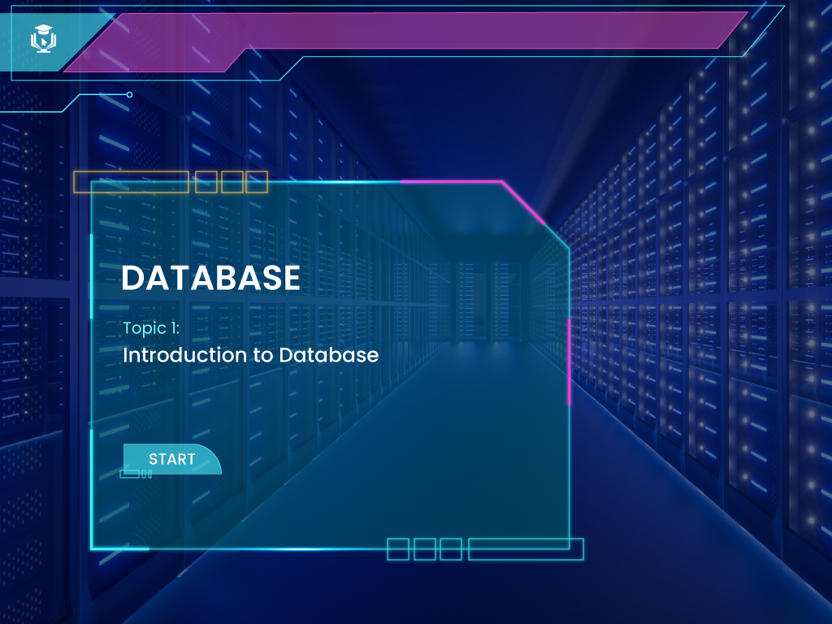

Menu:​
Topic Introduction​
Learning Objectives
Introduction to SQL Functions
Aggregate Functions
Scalar/Non-Aggregate Functions
Syntax Sheet
Summary​
Options on the output | YES/NO
Menu | N
Notes | N
Nxt button | N
Prev button | N
SUBMIT | N
Glossary | N
Marks | N
Attempts | N
Audio | N
Seekbar | N
9
Topic 5
Front End Beginners
SQL Sub-queries
Constraints
Notes:
Disclaimer: The images used in this storyboard are only for reference and should not be used for commercial purpose. Kindly purchase the image or recreate the same to avoid copyrights or royalty issues.
Designer Notes: 1) Autoplay the bitLabs intro video. Then navigate to this landing page with START button.

Slide 2
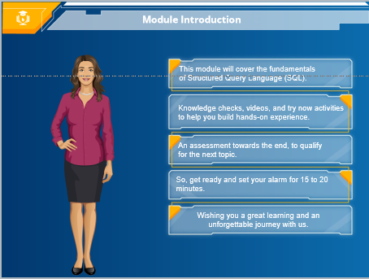
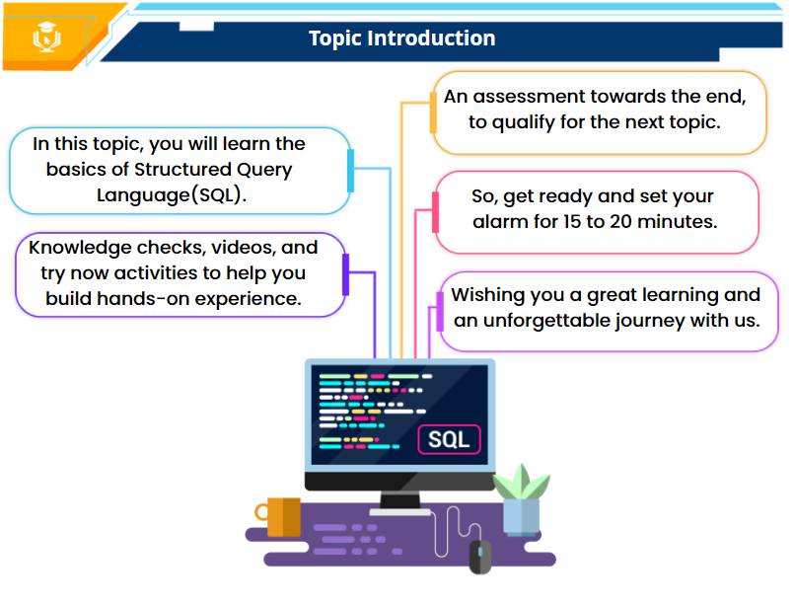
TOPIC INTRODUCTION
Notes:
Hi! Welcome back. In this topic, you will learn about sub-queries in SQL.
You will be provided with multiple learning objectives that come along with knowledge checks, videos, and try now activities to help you build hands-on experience on the concepts covered here.
You will also be provided with more intriguing and advanced assessment towards the end of the topic, to qualify yourself for the next one.
So, get ready to take your learning ahead and set your alarm for 15 to 20 minutes to complete this topic.
bitLabs wishes you a great learning and an unforgettable journey with us.
Options on the output | YES/NO
Menu | Y
Notes | Y
Next button | Y
Prev button | N
SUBMIT | N
Glossary | N
Marks | N
Attempts | N
In this topic, you will learn about sub-queries in SQL.
In this topic, you will learn about joins and views in SQL.
Notes:
Audio-VO1-Hi! Welcome back. Welcome back. In this topic, you will learn about sub-queries in SQL.
VO2-You will be provided with multiple learning objectives that come along with knowledge checks, videos, and try now activities to help you build hands-on experience on the concepts covered here. ​
​VO3-You will also be provided with more intriguing and advanced assessment towards the end of the topic, to qualify yourself for the next one. ​
​VO4-So, get ready to take your learning ahead and set your alarm for 15 to 20 minutes to complete this topic.
VO5-bitLabs wishes you a great learning and an unforgettable journey with us
Developer notes- Display the OSTs one by one in sync with the OSTs with the audio. ​

Slide 3
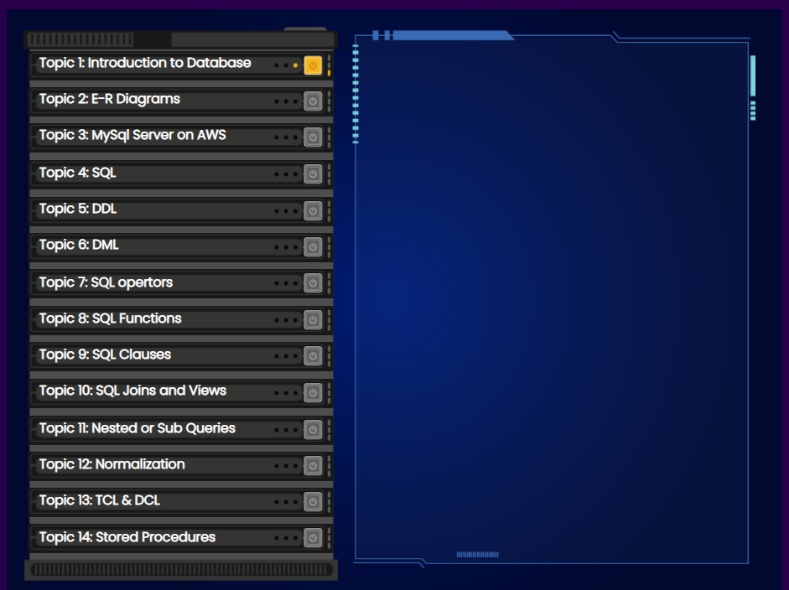
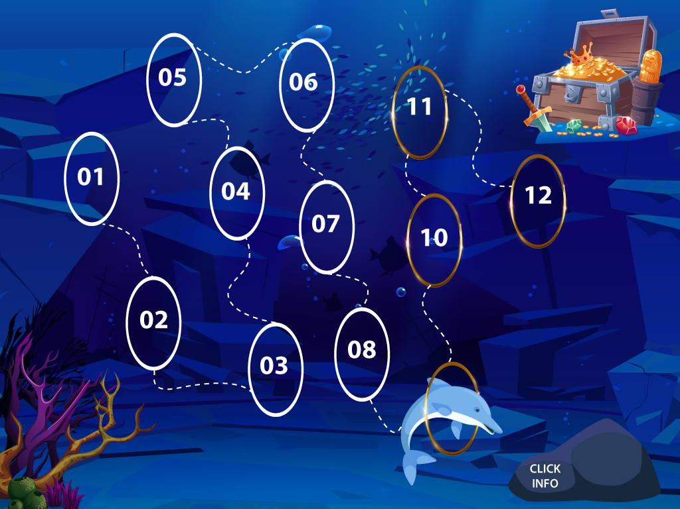
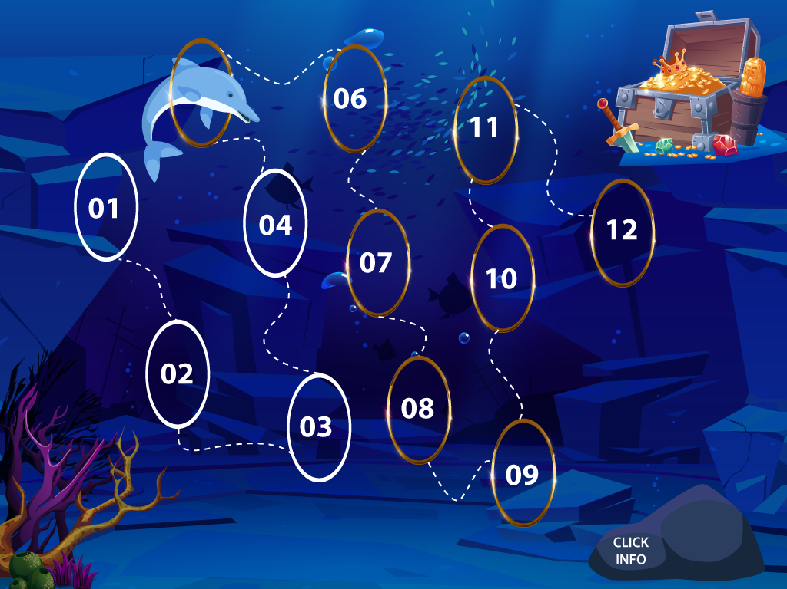

TOPIC INTRODUCTION
LEARNING PATH
Notes: ​
​
Before we begin, let's pause to check your progress. The completed topics are indicated by the highlighted rings. The dolphin diving through the ring, represents the current topic. Click on the shell displayed on screen to recollect the ground rules to navigate through the course, or click on the topic to begin with your learning.​​
Topic 4: Data Definition Language (DDL)
Options on the output | YES/NO
Menu | Y
Notes | Y
Next button | N
Prev button | N
SUBMIT | N
Glossary | N
Marks | N
Attempts | N
TOPIC INTRODUCTION
Hi! Welcome back. In this topic, you will learn about Data Manipulation Language (DDL). ​
You will be provided with knowledge checks, videos, and try now activities. ​
​
You will also be provided with assessment towards the end, to qualify yourself for the next one. ​
​
So, get ready and set your alarm for 15 to 20 minutes.​
​
BitLabs wishes you a great learning and an unforgettable journey with us.
Constraints
Data Manipulation Language (DML)
Topic 9
Click on the shell to recollect the rules
or click on the topic to begin.
Notes:
Audio- VO1-Before we begin, let's pause to check your progress.
VO2-The completed topics are indicated by the highlighted rings.
VO3-The dolphin diving through the ring, represents the current topic.
VO4-Click on the shell displayed on screen to recollect the ground rules to navigate through the course, or click on the topic to begin with your learning.
Developer notes- Display the bg in sync with the audio. ​
When clicked on shell, show a slide layer with OST – ‘Rules’ and provide ‘NEXT’ button there.
With VO4, show the click instruction-’Click on the shell to recollect the rules.’​

Slide 4

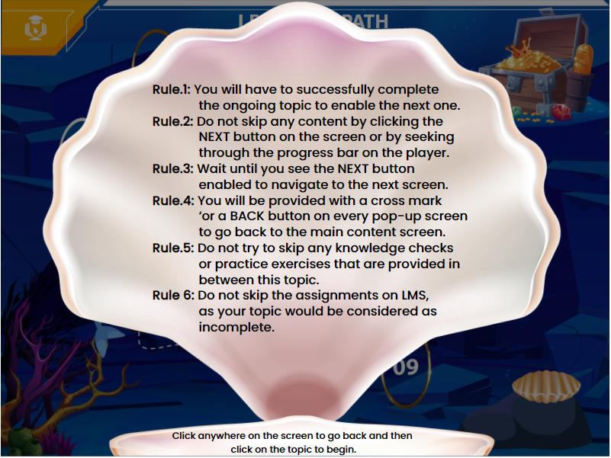

LEARNING PATH
There won’t be any patch in the final output.
Topic 4: Data Manipulation Language (DML)
In this topic, all the Learning objectives are locked and can be accessed one after the other, only after the successful completion of the ongoing objective. ​
Each objective will be provided with Knowledge Checks, and sometimes with explanatory Videos followed by Try Now exercises based on the concepts explained. ​
Remember not to skip any of these interactivities, for a hassle-free navigation.
The ‘Syntax Sheet’' slide towards the end is provided with a list of syntax used in this topic, for your quick reference. ​
The 'Glossary' tab containing all the technical terminologies used in this topic are provided with its description in an alphabetical order for your easy understanding. This can be accessed on all the slides. ​
The 'Menu' tab allows you to access only the visited slides. ​
The 'Notes' section contains the transcript for the audio used in this topic, which can be accessed on all the slides. ​
The 'Volume' button on the player helps you to adjust the audio volume to your preference, anytime. ​
The 'Revisit' option towards the end of this topic, helps you to retake this topic all over again, in case you fail or score low. ​
If you are passed and still want to 'Revisit' this topic on our LMS, then we suggest you to click the 'Continue/Revisit' button for an easy navigation. Clicking on 'Erase & Restart' option, can take you back to the start of the topic and you will not be given any access to skip the content.​
​
I have read and understood the above listed instructions. ​
Rule.1: You will have to successfully complete the ongoing topic to enable the next one.
Rule.2: Do not skip any content by clicking the NEXT button on the screen or by seeking through the progress bar on the player.
Rule.3: Wait until you see the NEXT button enabled to navigate to the next screen.
Rule.4: You will be provided with a cross mark or a BACK button on every pop-up screen to go back to the main content screen.
Rule.5: Do not try to skip any knowledge checks or practice exercises that are provided in between this topic.
Rule 6: Do not skip the assignments on LMS, as your topic would be considered as incomplete.
Options on the output | YES/NO
Menu | Y
Notes | Y
Next button | N
Prev button | N
SUBMIT | N
Glossary | N
Marks | N
Attempts | N
Click anywhere on screen to go back and then click
on the topic to begin.
PROCEED
Notes:
NO AUDIO

Slide 5
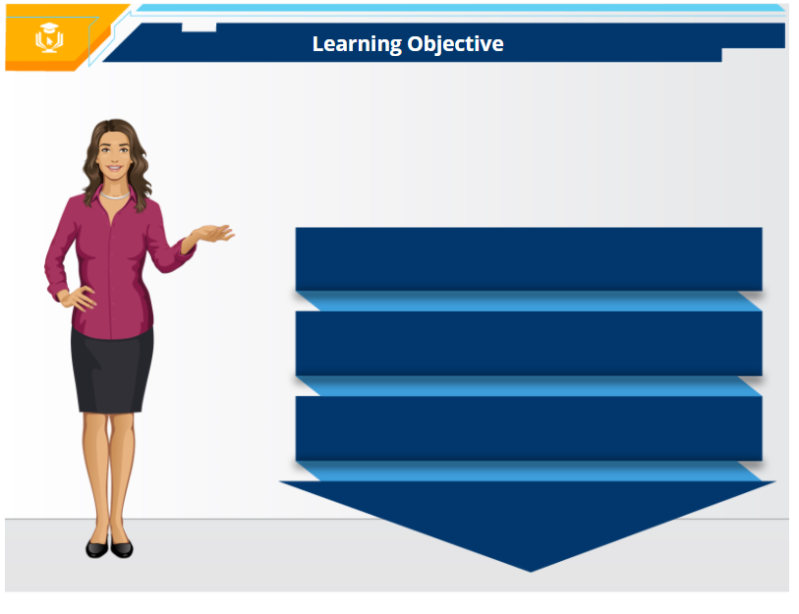
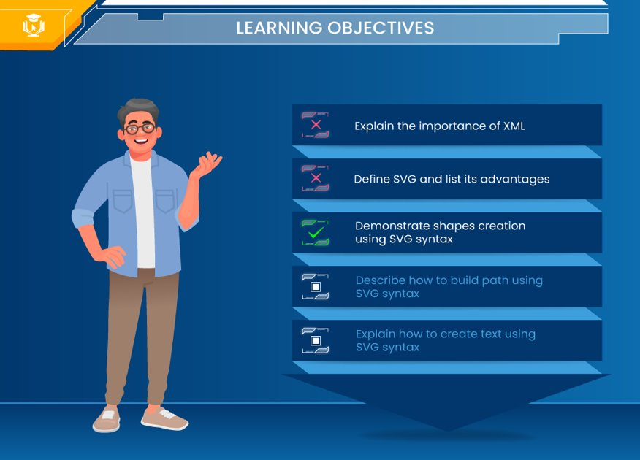








Options on the output | YES/NO
Menu | Y
Notes | Y
Nxt button | N
Prev button | N
SUBMIT | N
Glossary | N
Marks | N
Attempts | N
LEARNING OBJECTIVES
Define sub-query and its types in SQL
Notes:
By the end of this topic, you will be able to:
Define sub-query and its types in SQL
Explain sub-queries with SELECT statement
Explain sub-queries with INSERT statement
Explain sub-queries with UPDATE statement, and finally
Explain sub-queries with DELETE statement.
By the end of this topic, you will be able to:
Explain sub-queries with SELECT statement
Explain sub-queries with INSERT statement
Explain
Explain the types of aggregate functions with examples.
Explain sub-queries with UPDATE statement
Explain sub-queries with DELETE statement
Explain the types of scalar or non-aggregate functions with examples.
Click the enabled objective to explore.
Notes:
Audio: By the end of this topic, you will be able to:
Define sub-query and its types in SQL
Explain sub-queries with SELECT statement
Explain sub-queries with INSERT statement
Explain sub-queries with UPDATE statement, and finally
Explain sub-queries with DELETE statement.
Developer Notes: Don’t provide NEXT & PREV buttons on player. Display the tag line in the OST when the audio begins reading. Also display the OST one by one in sync with the audio. Every section will have to begin with this screen highlighting and unlocking the respective objective for the learner to access that particular section.
GD Note: 1) Need → abstract image for BG. Locked and unlocked icons also needed.

Slide 6
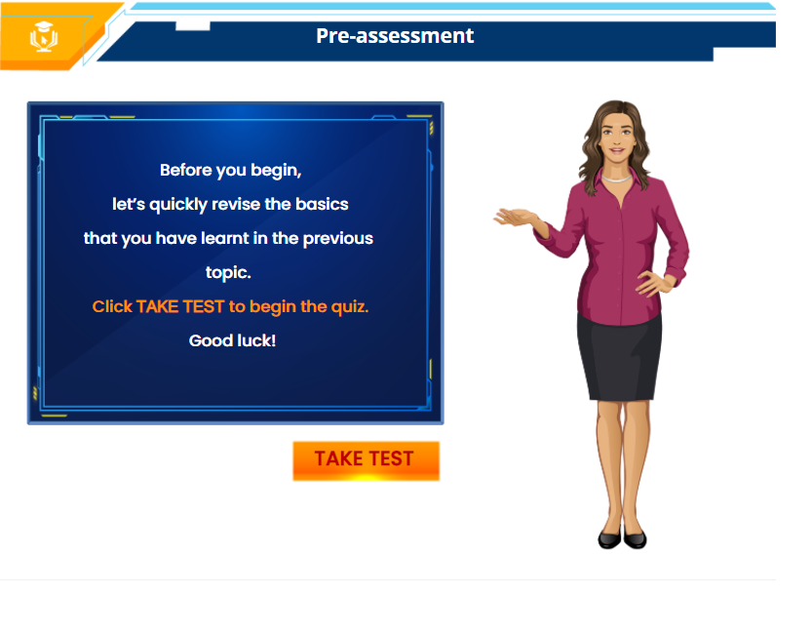
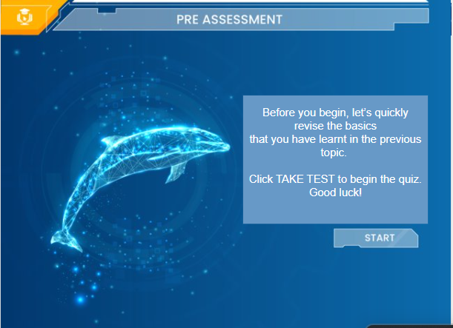
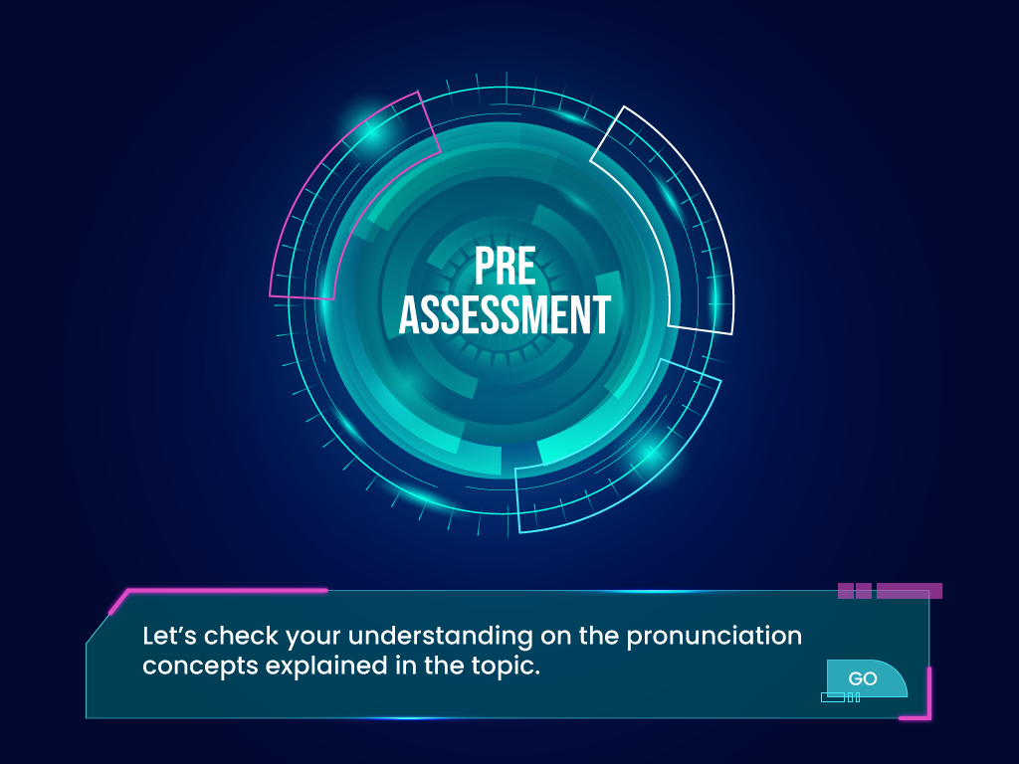
Before you begin,
let’s quickly revise the basics that you have learnt in the previous topic.
Click TAKE TEST to begin the quiz.
Good luck!
Pre-Assessment
Options on the output | YES/NO
Menu | Y
Notes | Y
Nxt button | N
Prev button | Y
SUBMIT | N
Glossary | N
Marks | N
Attempts | N
Take Test
Before you begin, let’s quickly revise the basics that you have learnt in the previous topic.
Click TAKE TEST to begin the quiz.
Good luck!
TAKE TEST
Notes:
Audio
VO1-Before you, let’s quickly revise the basics that you have learnt in the previous topics .
VO2-Click Take Test to begin the quiz.
VO3-Good luck!
Developer notes- Sync the OSTs with the audio.
Show <Take Test> with VO2.

Slide 7

Options on the output | YES/NO
Menu | N
Notes | N
Nxt button | N
Prev button | N
SUBMIT | Y
Glossary | N
Marks | 0
Attempts | 1
Pre-assessment: Question 1
Pre-Assessment: Question 1
Select the appropriate answer for the following question and click SUBMIT.
While writing a JOIN condition in SQL, what should be the number of join conditions in the WHERE clause if there are ‘n’ number of tables specified in the FROM clause?
A. n+1
B. n-1
C. n
D. 2n
Excellent! You are right.
While using SQL JOINS, the JOIN condition is always mentioned in the WHERE clause. Hence, if you have specified ‘n’ number of tables in the FROM clause, then there should be ‘n-1’ join conditions in the WHERE clause. Hence, the answer is n-1.
Notes:
Developer Note: Design is showed above for reference. Please provide 1 attempt.
Incorrect: The correct answer is: C
Explanation: Excellent! You are right. Excellent! You are right.
While using SQL JOINS, the JOIN condition is always mentioned in the WHERE clause. Hence, if you have specified ‘n’ number of tables in the FROM clause, then there should be ‘n-1’ join conditions in the WHERE clause. Hence, the answer is ‘n-1’. <Continue>
Correct feedback: That's right! <Get Going>

Slide 8
Options on the output | YES/NO
Menu | N
Notes | N
Nxt button | N
Prev button | N
SUBMIT | Y
Glossary | N
Marks | 0
Attempts | 1
Pre-assessment : Question 2
Pre-Assessment: Question 2
Select True or False for the following question and click SUBMIT.
Advantages of using SQL views are:
A. Simplifies complex query
B. Stores data physically
C. Enhances data security
D. All of these options
Excellent! You are right.
A view in SQL is a is a virtual table that help simplify complex queries and add layers of security to the data. However, the data is not physically stored in a view, hence the advantages of SQL views are: Simplifies complex query and enhances data security.
Notes:
Developer Note: Design is showed above for reference. Please provide 1 attempt.
1st attempt feedback: Try Again: That is not correct. Here is another chance, please try again. <TRY AGAIN BUTTON>
2nd attempt feedback: Incorrect: The correct answer is: Relational Operators
Explanation: Excellent! You are right. A view in SQL is a is a virtual table that help simplify complex queries and add layers of security to the data. However, the data is not physically stored in a view, hence the advantages of SQL views are: Simplifies complex query and enhances data security. <CONTINUE BUTTON>
Correct feedback: That's right! <Get Going BUTTON>

Slide 9

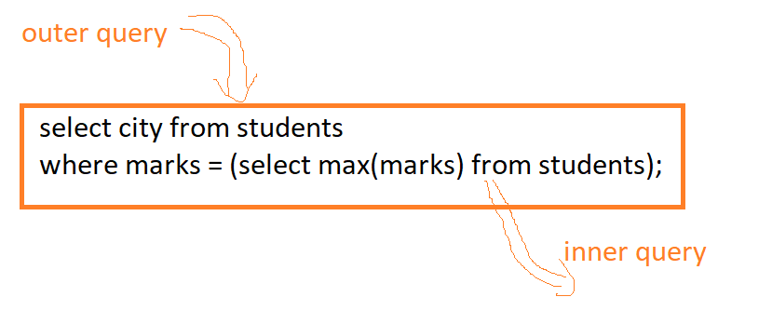
Introduction to SQL Sub-query
Outer Select Query
Notes:
So far we have learnt to write SQL queries to fetch the desired results from databases. In this topic, we will dive into the world of sub-queries and learn to use them efficiently. A sub-query or a nested query is a select query placed within another select query. The outcome of the outer select query is normally determined using the inner select query.
Take a look at a sample select query displayed on the screen. The query within the braces is the inner query and the one outside the braces is the outer query. The inner query gets executed first and its result is returned to the outer query, after which then outer query gets performed. Sub-queries can be used with SELECT, INSERT, UPDATE, and DELETE statements, as well as with operators such as equal to(=), greater than(>), greater than or equal to(>=), IN, BETWEEN, and so on.
Click the watch video play button to watch a video on SQL sub-queries.
Options on the output | YES/NO
Menu | Y
Notes | Y
Nxt button | N
Prev button | Y
SUBMIT | N
Glossary | Y
Marks | N
Attempts | N
Outcome of the outer is determined
by the inner one.
Query
SQL
Avatar
Inner Select Query
SQL Sub
Query
Inner Select Query
SQL Sub
Query
Database
Notes:
Audio: VO1-So far we have learnt to write SQL queries to fetch the desired results from databases.
VO2-In this topic, we will dive into the world of sub-queries and learn to use them efficiently.
VO3-A sub-query or a nested query is a select query placed within another select query.
VO4-The outcome of the outer select query is normally determined using the inner select query.
VO5-Take a look at a sample select query displayed on the screen.
VO6-The query within the braces is the inner query and the one outside the braces is the outer query.
VO7-The inner query gets executed first and its result is returned to the outer query, after which then outer query gets performed.
VO8- Sub-queries can be used with SELECT, INSERT, UPDATE, and DELETE statements, as well as with operators such as equal to(=), greater than(>), greater than or equal to(>=), IN, BETWEEN, and so on.
VO9-Click the video play button to watch a video on sub-queries.
Developer Notes: With VO1, show avatar and the image at the right.
With VO2, show the image at the left of the avatar.
With VO3, remove the avatar, and the database image and move the sub-query image to the centre and label ‘Query’ within it.
With VO4, label ‘Outer Select Query’ and ‘Inner Select Query’ and show OST-’ Outcome of the outer is determined by the inner one.’
With VO5, show the sample query with labels.
With VO6, show the arc arrow from inner to outer query.
GD Note:

Slide 10
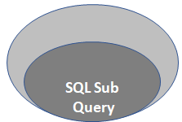

Sub-queries are used with statements and operators.
SELECT
INSERT
UPDATE
DELETE
Equal to(=)
Greater than(>)
Greater than or equal to(>=)
IN
BETWEEN
Notes:
Visualization for VO8 and VO9.

Slide 11
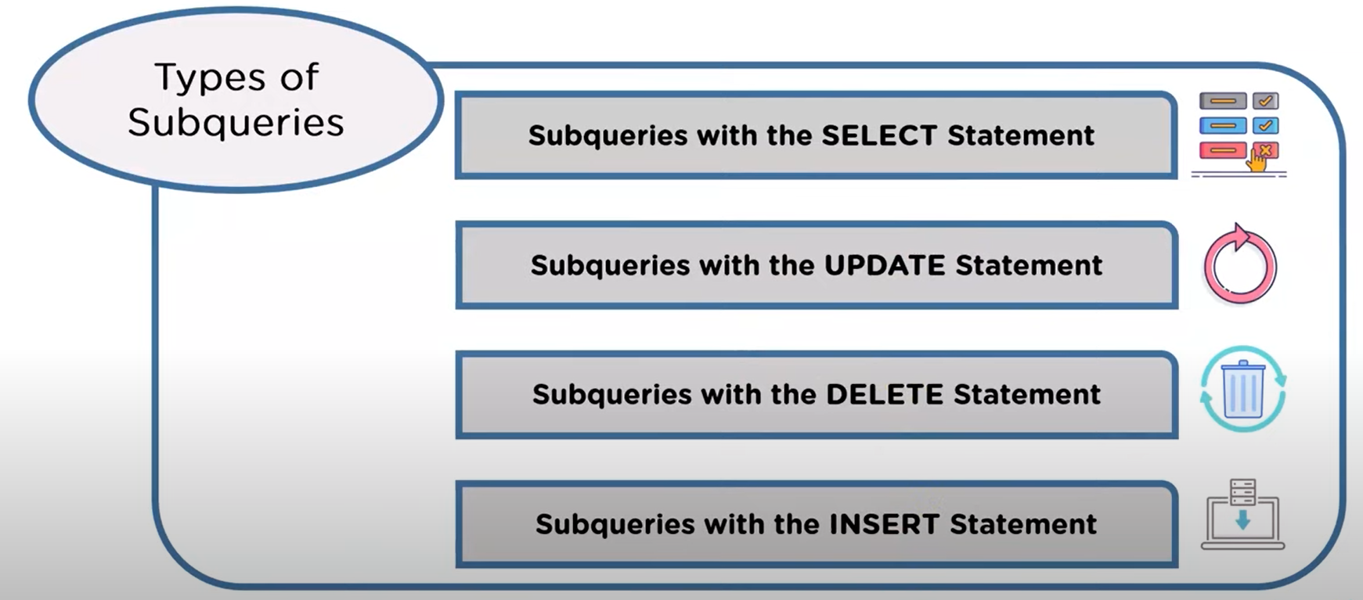
Types of Sub-query
Notes:
Based on the statement the sub-query is used with, there are four types of sub-queries in SQL. They are:
Sub-queries with the SELECT statement,
Sub-queries with the UPDATE statement,
Sub-queries with the DELETE statement, and
Sub-queries with the INSERT statement.
We will explore each of these types in the upcoming slides.
Notes:
Audio-Based on the statement the sub-query is used with, there are four types of sub-queries in SQL. They are:
Sub-queries with the SELECT statement,
Sub-queries with the UPDATE statement,
Sub-queries with the DELETE statement, and
Sub-queries with the INSERT statement.
We will explore each of these types in the upcoming slides.
Developer notes- Show the OSTs one by one in sync with the audio.

Slide 12
Knowledge Check: Question 1
Select the appropriate answer for the following statement and click SUBMIT.
Nested queries cannot used with comparison operators.
True
False
Excellent! You are right.
Nested queries or sub-queries can be used with comparison operators such as ‘equal to(=)’, ‘greater than(>)’, ‘less than(<)’, and so on, to compare the output of the sub-query with the outer query. Hence, the given statement is False.
Notes:
Answer: False
Developer Note: Design is showed above for reference.
Incorrect feedback: Try Again: That is not correct. Nested queries or sub-queries can be used with comparison operators such as ‘equal to(=)’, ‘greater than(>)’, ‘less than(<)’, and so on, to compare the output of the sub-query with the outer query. Hence, the given statement is false.<Continue>
Explanation: Excellent! You are right. Nested queries or sub-queries can be used with comparison operators such as ‘equal to(=)’, ‘greater than(>)’, ‘less than(<)’, and so on, to compare the output of the sub-query with the outer query. Hence, the given statement is false.<Get Going>
Marks: 10

Slide 13
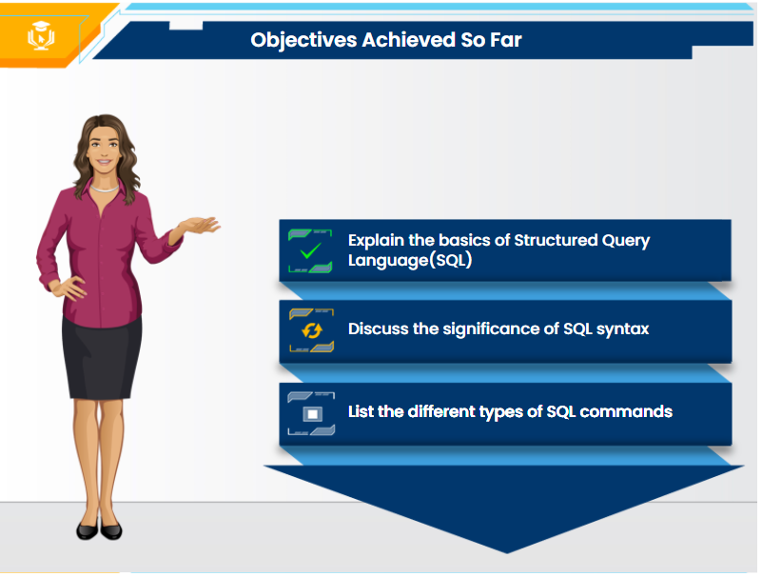





Define sub-query and its types in SQL
No Audio
Define sub-query and its types in SQL
Explain sub-queries with SELECT statement
Explain sub-queries with INSERT statement
Define sub-query and its types in SQL
Define functions and its types in SQL
Define sub-query and its types in SQL
Explain the types of aggregate functions with examples.
Explain sub-queries with UPDATE statement
Explain the types of scalar or non-aggregate functions with examples.
Define sub-query and its types in SQL
Explain sub-queries with DELETE statement
Click the enabled objective to explore.

Slide 14
Sub-queries with SELECT statement
SELECT query
Notes:
Sub-queries are majorly used with the select statement, the basic syntax for which is displayed on the screen.
As we have already seen examples of select sub-queries in the video, we will now find out how are these used with operators. We will also learn about how to can we place sub-queries in the FROM clause.
Click on each type of sub-query to know more.
Sub-query
Syntax for sub-query with SELECT:
select column_name from table where column_name operator
(select column_name from table[where]);
Sub-query with Comparison Operators
Sub-query with IN and NOT IN
Operators
Sub-query in the FROM clause
Click on each type of sub-query to know more.
Notes:
Audio-VO1-Sub-queries are majorly used with the select statement, the basic syntax for which is displayed on the screen.
VO2-As we have already seen examples of select sub-queries in the video, we will now find out how are these used with operators.
VO3-We will also learn how can we place sub-queries in the FROM clause.
VO4-Click on each type of sub-query to know more.
Developer notes- With VO1, show the image and the syntax.
With VO2, show the upper two buttons for sub-queries with operators.
With VO3, show the from clause button.
With VO4, show click instruction.

Slide 15
Sub-query with Comparison Operators
Notes:
We can use comparison operators such as ‘equal to(=)’, ‘greater than(>)’ or ‘less than(<)’, to compare the single value output of the sub-query with the expression in the WHERE clause. Take a look at the sample query that returns the customer information with highest payment from the given ‘Payments’ table. Here, the sub-query will return the maximum amount from the amount column which is 34000, and then the outer query will display customer number, check number and amount columns corresponding to the amount 34000.
Besides the equal to (=) operator, we can use other comparison operators such as greater than (>), greater than or equal to (>=) less than(<), and less than or equal to (<=). For example, let’s find customers whose payments are greater than the average payment using a sub-query, as displayed on the screen.
Greater than (>), greater than or equal to (>=) less than(<), and less than or equal to (<=).
Comparison operators compares the single value output of the sub-query with the expression in the WHERE clause.
customerNumber | checkNumber | amount
141 | JE105407 | 10000
142 | JE108408 | 34000
143 | JE145491 | 5000
144 | JE105408 | 3400
145 | JE105413 | 7600
customerNumber | checkNumber | amount
141 | JE105407 | 10000
142 | JE108408 | 34000
143 | JE145491 | 5000
144 | JE105408 | 3400
145 | JE105413 | 7600
Displays customerNumber, checkNumber and amount columns whose amount is greater than12000.
Displays customerNumber, checkNumber and amount
columns whose amount is equals to 34000.
SELECT customerNumber, checkNumber,amount FROM payments
WHERE amount > (SELECT AVG(amount) FROM payments);
SELECT customerNumber, checkNumber, amount from payments
WHERE amount = (SELECT MAX(amount) FROM payments);
Returns the average amount from the amount column = 12000
Returns maximum amount from
the amount column = 34000
Output
customerNumber | checkNumber | amount
142 | JE108408 | 34000
customerNumber | checkNumber | amount
142 | JE108408 | 34000
Output
Notes:
Slide layer
Audio-VO1-We can use comparison operators such as ‘equal to(=)’, ‘greater than(>)’ or ‘less than(<)’, to compare the single value output of the sub-query with the expression in the WHERE clause.
VO2-Take a look at the sample query that returns the customer information with highest payment from the given ‘Payments’ table.
VO3-Here, the sub-query will return the maximum amount from the amount column which is 34000,
VO4-and then the outer query will display customer number, check number and amount columns corresponding to the amount 34000.
VO5-Besides the equal to (=) operator, we can use other comparison operators such as greater than (>), greater than or equal to (>=) less than(<), and less than or equal to (<=).
VO6-For example, let’s find customers whose payments are greater than the average payment using a sub-query, as displayed on the screen.
Developer notes- With VO1, show the OST at the top.
With VO2, show the table and the query below.
With VO3, highlight the query as highlighted in red and show the OST below it.
With VO4, highlight the query as highlighted in yellow and show the OST above it, and then show the output.
With VO5, refer to the visual at the left side of the slide, change the OST at the top to – ‘Greater than (>), greater than or equal to (>=) less than(<), and less than or equal to (<=).’
With VO6, show the query with highlights and labels, and output.

Slide 16
Sub-query with IN and NOT IN Operators
Notes:
If a sub-query returns more than one value, we can use operators such as IN or NOT IN in the WHERE clause. Let’s look at an example. Consider two tables customers and orders. Customer table contains ‘Customer number,’ ‘Name’ and ‘Salary’ as column names and order table contains ‘Customer number’, ‘Order id’ and ‘order amount’ as column names.
Now, take a look at the sample sub-query with NOT IN operator to display the customers who have not placed any orders. Here, the sub-query returns a list of unique customer numbers from the orders table and then the outer query displays the list of customers whose customer numbers are not present in orders table.
Click the watch video button to explore a video on sub-queries with comparison, IN and NOT IN operators.
If a sub-query returns more than one value, then IN or NOT IN operators can be used in the WHERE clause.
Table: Customers
customer Number | Name | Salary
141 | Naveen | 10000
142 | Jithendra | 34000
143 | Vamshi | 20000
144 | Rajesh | 15000
145 | Sravani | 5000
146 | Poojith | 3400
147 | Raghava | 7600
Table: Orders
customer Number | Order id | Order amount
141 | O301 | 5000
142 | O302 | 4000
143 | O303 | 3000
144 | O304 | 4500
SELECT customerNumber FROM customers
WHERE customerNumber NOT IN (SELECT DISTINCT customerNumber FROM orders);
Returns a list of unique customer
numbers from the orders table
customerNumber
145
146
147
Output
Notes:
Slide layer
Audio-VO1-If a sub-query returns more than one value, we can use operators such as IN or NOT IN in the WHERE clause. Let’s look at an example.
VO2-Consider two tables customers and orders. Customer table contains ‘Customer number,’ ‘Name’ and ‘Salary’ as column names and order table contains ‘Customer number’, ‘Order id’ and ‘order amount’ as column names.
VO3-Now, take a look at the sample sub-query with NOT IN operator to display the customers who have not placed any orders.
VO4-Here, the sub-query returns a list of unique customer numbers from the orders table and then the outer query displays the list of customers whose customer numbers are not present in orders table.
VO5- Click the watch video button to watch a video on sub-queries with comparison, IN and NOT IN operators.
Developer notes- With VO1, show the OST at the top.
With VO2, show the two tables and highlight the columns with the audio.
With VO3, show the query.
With VO4, highlight the query in red as shown and show the OST given in yellow.
With VO5, show the video play button.

Slide 17
Sub-query in the FROM clause
Notes:
Sub-queries are most commonly placed in the WHERE clause in a SELECT statement, but they can also form a part of the FROM clause. When it is used in the FROM clause, the result set returned from a sub-query is used as a temporary table, referred to as a derived table sub-query.
Using the orders details table displayed on the screen, let’s take a look at the sample sub-query in the FROM clause that finds the average number of items in sale orders. The output is displayed on the screen.
Click the watch video play button to explore watch a video on sub-query with FROM clause.
SELECT column_name FROM (SELECT column_name(s)from table_name) as table_name
WHERE condition;
Result set returned from the
sub-query is used as a temporary table: Derived table sub-query
Table: Ordersdetails
customer Number | Order id | Order amount
141 | O301 | 5000
142 | O302 | 4000
143 | O303 | 3000
144 | O304 | 4500
SELECT
FLOOR(AVG(items))
FROM (SELECT orderNumber, COUNT(orderNumber) AS items
FROM orderdetails
GROUP BY orderNumber) AS lineitems;
Output:
floor(avg(items))
9
Notes:
Audio-VO1-Sub-queries are most commonly placed in the WHERE clause in a SELECT statement, but they can also form a part of the FROM clause.
VO2-When it is used in the FROM clause, the result set returned from a sub-query is used as a temporary table, referred to as a derived table sub-query.
VO3-Using the ordersdetails table displayed on the screen, let’s take a look at the sample sub-query in the FROM clause that finds the average number of items in sale orders.
VO4-The output is displayed on the screen.
VO5-Click the video play button to watch a video on sub-query with FROM clause.
Developer notes- With VO1, show the syntax given in green and highlight the yellow part.
With VO2, show the arrow and the OST in white.
With VO3, show the table and the query.
With VO4, show the output.
With VO5, show the video play button.

Slide 18
Knowledge Check: Question 2
Select the appropriate answer for the following statement and click SUBMIT.
Sub-queries can be placed in:
SELECT clause
FROM clause
WHERE clause
All of these options
Excellent! You are right.
Sub-queries can be used with SELECT, FROM and WHERE clause. Hence, all the given three options are correct.
Notes:
Answer: All of these options
Developer Note: Design is showed above for reference.
Incorrect feedback: Try Again: Sub-queries can be used with SELECT, FROM and WHERE clause. Hence, all of the given three options are correct.<Continue>
Explanation: Excellent! You are right. Sub-queries can be used with SELECT, FROM and WHERE clause. Hence, all of the given three options are correct.<Get Going>
Marks: 10

Slide 19

No Audio
Define sub-query and its types in SQL
Define sub-query and its types in SQL
Explain sub-queries with SELECT statement
Explain sub-queries with INSERT statement
Define sub-query and its types in SQL
Define functions and its types in SQL
Define sub-query and its types in SQL
Explain the types of aggregate functions with examples.
Explain sub-queries with UPDATE statement
Explain the types of scalar or non-aggregate functions with examples.
Define sub-query and its types in SQL
Explain sub-queries with DELETE statement
Click the enabled objective to explore.

Slide 20
Sub-queries with INSERT statement
Notes:
The insert statement uses the data returned from the sub-query to insert into another table. Its syntax is displayed on the screen. Let’s now find out how to use sub-query with insert statement using an example.
We will write a query to insert products information from the products table into an orders table for products whose sell_price is greater than thousand. The products table is displayed on the screen. Here, sub-query returns the list of product_ids whose sell_price is greater than 1000 and the outer query will insert the output returned by the sub-query into the orders table. The output returned after completion of the insert operation is as displayed on the screen.
Click the watch video button to explore watch a video on sub-query with insert statement.
Uses the data returned from the sub-query to insert into another table.
Syntax for sub-query with INSERT:
insert into table_name select * from table
where value operator (inner query)
Sell_price>1000
Output Table: Orders
Table: Products
Product id | P_name | Sell_price
101 | Laptop | 45000
102 | Camera | 34000
105 | Table | 2300
106 | Mobile | 20000
Product id | P_name | Sell_price
101 | Laptop | 45000
102 | Camera | 34000
103 | Soap | 50
104 | Pen | 200
105 | Table | 2300
106 | Mobile | 20000
Inserts sub-query’s output into orders table
insert into orders select Product_id, p_name, sell_price from products where product_id in (select Product_id from products where sell_price>1000);
Returns list of Product_ids, where Sell_price>1000
Notes:
Audio-VO1-The insert statement uses the data returned from the sub-query to insert into another table.
VO2-Its syntax is displayed on the screen. Let’s now find out how to use sub-query with insert statement using an example.
VO3-We will write a query to insert products information from the products table into an orders table for products whose sell_price is greater than thousand. The products table is displayed on the screen.
VO4-Here, sub-query returns the list of product_ids whose sell_price is greater than 1000 and the outer query will insert the output returned by the sub-query into the orders table.
VO5-The output returned after completion of the insert operation is as displayed on the screen.
Developer notes- With VO1, show the OST at the top.
With VO2, show the syntax.
With VO3, show the table and the query.
With VO4, show the highlights and labels in the query.
With VO5, show the output table with highlights.

Slide 21
Knowledge Check: Question 3
Select the appropriate answer for the following statement and click SUBMIT.
Which of the following is the correct syntax for sub-query with INSERT statement?
insert (inner query)
into table_name
select * from table
where value operator
A.
B.
insert into table_name select * from table
where value operator (inner query)
C.
D.
insert into table_name select * from table (inner query)
where value operator
insert into table_name select * from table
where (inner query) value operator
Excellent! You are right.
The insert statement uses the data returned from the sub-query to insert into another table. Hence, its correct syntax is:
insert into table_name select * from table
where value operator (inner query)
Notes:
Answer: B
Developer Note: Design is showed above for reference.
Incorrect feedback: Try Again: The insert statement uses the data returned from the sub-query to insert into another table. Hence, its correct syntax is:
insert into table_name select * from table
where value operator (inner query) <Continue>
Explanation: Excellent! You are right. The insert statement uses the data returned from the sub-query to insert into another table. Hence, its correct syntax is:
insert into table_name select * from table
where value operator (inner query) <Get Going>
Marks: 10

Slide 22

Define sub-query and its types in SQL
No Audio
Define sub-query and its types in SQL
Explain sub-queries with SELECT statement
Explain sub-queries with INSERT statement
Define sub-query and its types in SQL
Define functions and its types in SQL
Define sub-query and its types in SQL
Explain the types of aggregate functions with examples.
Explain sub-queries with UPDATE statement
Explain the types of scalar or non-aggregate functions with examples.
Define sub-query and its types in SQL
Explain sub-queries with DELETE statement
Click the enabled objective to explore.

Slide 23
Sub-queries with UPDATE statement
Notes:
Let’s find out how can we use update statements in sub-queries using an example. Using the same products table used previously, we will write a query to add ten percent discount to the all the products whose sell_price is greater than two thousand. Here, the sub-query will return the list of products with sell_price greater than 2000, i.e., 45000,34000,2300 and 20000.
The outer query will then add discounts to the sell_price column values with sell_price greater than 2000. So here is the output after the completion of the update operation.
Click the watch video button to explore watch a video on sub-query with UPDATE statement.
Output after adding 10% discount to sell_price>2000
Table: Products
Product id | P_name | Sell_price
101 | Laptop | 45000
102 | Camera | 34000
103 | Soap | 50
104 | Pen | 200
105 | Table | 2300
106 | Mobile | 20000
Output Table
Product id | Sell_price
101 | 40500
102 | 30500
103 | 50
104 | 200
105 | 2300
106 | 18000
Adds 10% discounts to sell_price
Update orders set sell_price=sell_price-(sell_price*0.10) where sell_price in
(select sell_price from products where sell_price>2000;
Returns list of Product_ids, where Sell_price>2000
Notes:
Audio-VO1-Let’s find out how can we use update statements in sub-queries using an example.
VO2-Using the same products table used previously, we will write a query to add ten percent discount to the all the products whose sell_price is greater than two thousand.
VO3-Here, the sub-query will return the list of products with sell_price greater than 2000, i.e., 45000,34000,2300 and 20000.
VO4-The outer query will then add discounts to the sell_price column values with sell_price greater than 2000.
VO5-So here is the output after the completion of the update operation.
VO6-Click the watch video button to watch a video on sub-query with UPDATE statement.
Developer notes- With VO1, show the avatar.
With VO2, show the table and the query.
With VO3, show the red highlights on the query with labels.
With VO4, show the yellow highlights on the query with labels.
With VO5, show the output with highlights.
With VO6, show the video button.

Slide 24
Knowledge Check: Question 4
Select the appropriate answer for the following statement and click SUBMIT.
Consider a table named ‘product’ with column names as ‘product_id’ and ‘category_id’; what would be the output of the given query?
A.
product_id for all products that are in category 4 are updated to category 5.
UPDATE (SELECT product_id, category_id FROM product) SET category_id = 5 WHERE category_id = 4;
product_id for all products that are in category 5 are updated to category 4.
B.
C.
category_id for all products that are in category 4 are updated to category 5.
category_id for all products that are in category 5 are updated to category 4.
D.
Excellent! You are right.
The given query uses a sub-query in an UPDATE statement for the table to be updated. The correct output of the query is: category_id for all products that are in category 4 are updated to category 5.
Notes:
Answer: C
Developer Note: Design is showed above for reference.
Incorrect feedback: Try Again: The given query uses a sub-query in an UPDATE statement for the table to be updated. The correct output of the query is: category_id for all products that are in category 4 are updated to category 5.<Continue>
Explanation: Excellent! You are right. The given query uses a sub-query in an UPDATE statement for the table to be updated. The correct output of the query is: category_id for all products that are in category 4 are updated to category 5.<Get Going>
Marks: 10

Slide 25


Define sub-query and its types in SQL
No Audio
Define sub-query and its types in SQL
Explain sub-queries with SELECT statement
Explain sub-queries with INSERT statement
Define sub-query and its types in SQL
Define functions and its types in SQL
Define sub-query and its types in SQL
Explain the types of aggregate functions with examples.
Explain sub-queries with UPDATE statement
Explain the types of scalar or non-aggregate functions with examples.
Define sub-query and its types in SQL
Explain sub-queries with DELETE statement
Click the enabled objective to explore.

Slide 26
Sub-queries with DELETE statement
Notes:
The sub-queries can be used in conjunction with delete statement, the syntax for which is displayed on the screen. Referring to the same products table, let’s take a look at a sample query that uses a sub-query to return the records of products with Sell_price less than or equal to five hundred, i.e. 50 and 200 and then uses the output to delete the records of such products.
The output table, after deletion of records for products with id, 103 and 104, is as displayed on the screen.
Click the watch video button to explore watch a video on sub-query with DELETE statement.
Syntax for sub-query with DELETE:
delete from table_name where operator value (inner query);
Output Table
Table: Products
Product id | P_name | Sell_price
101 | Laptop | 45000
102 | Camera | 34000
105 | Table | 2300
106 | Mobile | 20000
Product id | P_name | Sell_price
101 | Laptop | 45000
102 | Camera | 34000
103 | Soap | 50
104 | Pen | 200
105 | Table | 2300
106 | Mobile | 20000
Delete the records of products with Sell_price<=500
delete from products where sell_price in
(select sell_price from product2 where sell_price<=500);
Returns the records of products with Sell_proce<=500
Notes:
Audio-VO1-The sub-queries can be used in conjunction with delete statement, the syntax for which is displayed on the screen.
VO2-Referring to the same products table, let’s take a look at a sample query that uses a sub-query to return the records of products with Sell_price less than or equal to five hundred, i.e. 50 and 200
VO3-and then uses the outer query to delete the records of such products.
VO4-The output table, after deletion of records for products with id, 103 and 104, is as displayed on the screen.
VO5-Click the watch video button to watch a video on sub-query with DELETE statement.
Developer notes- With VO1, show the syntax.
With VO2, show the table and the query with highlights on the table, the red highlight and label on the query.
With VO3, show the yellow highlight and the label.
With VO4, show the output table.
With VO5, show the video button.

Slide 27
Knowledge Check: Question 5
Select the appropriate answer for the following statement and click SUBMIT.
In the given sub-query, the output of the DELETE statement is used to execute the inner query. Verify whether the statement is true or false by examining the facts.
A.
True
DELETE FROM CUSTOMERS
WHERE AGE IN (SELECT AGE FROM CUSTOMERS_BKP
WHERE AGE >= 27 );
B.
False
Excellent! You are right.
In a sub-query with DELETE statement, the sub-query is executed first, whose output is then used to execute the DELETE statement. Hence, the given statement is False.
Notes:
Answer: False
Developer Note: Design is showed above for reference.
Incorrect feedback: Try Again: In a sub-query with DELETE statement, the sub-query is executed first, whose output is then used to execute the DELETE statement. Hence, the given statement is false.<Continue>
Explanation: Excellent! You are right. In a sub-query with DELETE statement, the sub-query is executed first, whose output is then used to execute the DELETE statement. Hence, the given statement is false.<Get Going>
Marks: 10

Slide 28
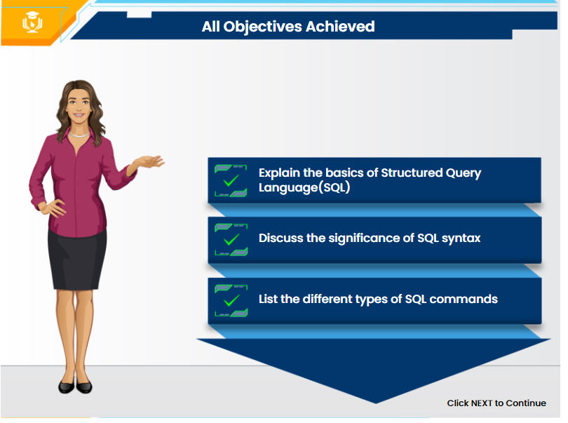

Options on the output | YES/NO
Menu | Y
Notes | Y
Nxt button | N
Prev button | N
SUBMIT | N
Glossary | N
Marks | N
Attempts | N
Objectives Achieved So Far
Define sub-query and its types
By the end of this topic, you will be able to:
No audio
Describe constraints in SQL
Explain sub-queries with SELECT statement
Explain the use of INSERT command
Explain the different SQL constraints with examples
Explain sub-queries with INSERT statement
Define functions and its types in SQL
Explain the use of SELECT command
Demonstrate the use of SELECT
Command with example
Explain sub-queries with UPDATE statement
Explain the types of aggregate functions with examples.
Explain th
e use of UPDATE command
Identify the use of UPDATE command and explain it with an example
Explain sub-queries with DELETE statement
Explain the types of scalar or non-aggregate functions with examples.
Describe the use of DELETE command with example
Explain the use of DELETE command
Notes:
No Audio

Slide 29
Syntax Sheet
06
The syntaxes covered in this topic are given below:
Notes:
Let us now look at the syntaxes covered in this topic.
Options on the output | YES/NO
Menu | Y
Notes | Y
Glossary | Y
Next button | Y
Prev button | Y
SUBMIT | N
Marks | N
Attempts | N
Command | Syntax
Sub-query with SELECT statement | select column_name from table where column_name operator (select column_name from table[where]);
Sub-query with INSERT statement: | insert into table_name select * from table where value operator (inner query)
Sub-query with DELETE statement: | delete from table_name where operator value (inner query);
Notes:
Audio: Let us now look at the syntaxes covered in this topic.

Slide 30
Glossary
S.no | Description
Delete Statement | It is used to delete existing records in a table.
Insert statement | It writes new rows of data into a table, and it returns the number of rows inserted into the table.
Sub-query | A sub-query or a nested query is a select query placed within another select query.
Update Statement | It is used to modify the existing records in a table.

Slide 31

Summary
Notes:
With this we have come to the end of the topic, so before we move on to the next one, let’s recap the concepts learned so far:
A sub-query or a nested query is a select query placed within another select query. The outcome of the outer select query is normally determined using the inner select query
Based on the statement the sub-query is used with, there are four types of sub-queries in SQL. They are:
Sub-queries with the SELECT statement,
Sub-queries with the UPDATE statement,
Sub-queries with the DELETE statement, and
Sub-queries with the INSERT statement.
Options on the output | YES/NO
Menu | Y
Notes | Y
Nxt button | Y
Prev button | Y
SUBMIT | N
Glossary | Y
Marks | N
Attempts | N
With this we have come to the end of the topic, so before we move on to the next one, let’s recap the concepts learned so far:
A sub-query or a nested query is a select query placed within another select query. The outcome of the outer select query is normally determined using the inner select query
Based on the statement the sub-query is used with, there are four types of sub-queries in SQL. They are:
Sub-queries with the SELECT statement,
Sub-queries with the UPDATE statement,
Sub-queries with the DELETE statement, and
Sub-queries with the INSERT statement.
Notes:
Audio: A sub-query or a nested query is a select query placed within another select query. The outcome of the outer select query is normally determined using the inner select query
Based on the statement the sub-query is used with, there are four types of sub-queries in SQL. They are:
Sub-queries with the SELECT statement,
Sub-queries with the UPDATE statement,
Sub-queries with the DELETE statement, and
Sub-queries with the INSERT statement.
Graphic designer notes:
Use front end template for this slide only.
Developer notes:
Show all the notes one by one with animation. Sync the audio with the OST

Slide 32
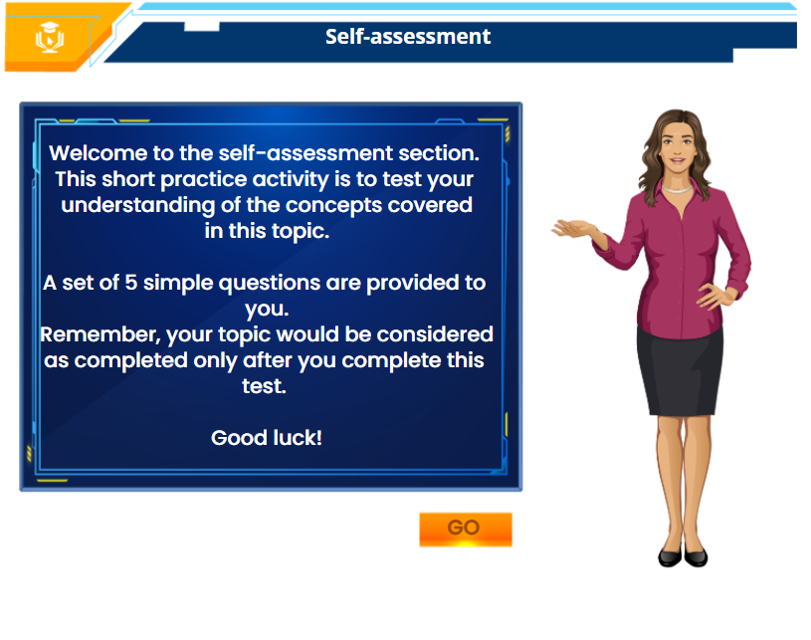

Notes:
Welcome to the self-assessment section. This short practice activity is to test your understanding of the concepts covered in this topic.
A set of 5 simple questions are provided to you. Remember, your topic would be considered as completed only after you complete this test.
Good luck!
Welcome to the self-assessment section. This short practice activity is to test your understanding of the concepts covered in this topic.
A set of 5 simple questions are provided to you. Remember, your topic would be considered as completed only after you complete this test.
Good luck!
Go
Click NEXT to begin the test.
Notes:
Audio: Welcome to the self-assessment section. This short practice activity is to test your understanding of the concepts covered in this topic. A set of 5 simple questions are provided to you. Remember, your topic would be considered as completed only after you complete the test. Good luck! Click next to begin the test.
Graphics Note: The images used in this storyboard are only for reference and should not be used for commercial purpose. Kindly purchase the image or recreate the same to avoid copyrights or royalty issues.

Slide 33
Options on the output | YES/NO
Menu | N
Notes | N
Nxt button | N
Prev button | N
SUBMIT | Y
Glossary | N
Marks | 5
Attempts | 2
Self-assessment: Question 1
Select the appropriate answer for the following question and click SUBMIT.
Assuming the table name as Student, what could be is the result for the of following query? Assume the table name is Student.
A. The query gives the information of students with maximum score.
B. The query gives the information of students with least score.
C. The query is syntactically incorrect
D. The query the information of students with marks greater than 0.
Select * from student where marks= (select max(marks) from student);
Excellent! You are right.
In the given query, first the sub-query ‘select max(marks) from student’ will be executed that will provide the maximum score. Followed by the outer query that will print all the student's information with maximum score. Hence, the given query gives the information of students with maximum score.
Notes:
Answer: A
Developer Note: Design is showed above for reference.
Explanation:In the given query, first the sub-query ‘select max(marks) from student’ will be executed that will provide the maximum score. Followed by the outer query that will print all the student's information with maximum score. Hence, the given query gives the information of students with maximum score.<Continue>
Correct feedback: That's right! In the given query, first the sub-query ‘select max(marks) from student’ will be executed that will provide the maximum score. Followed by the outer query that will print all the student's information with maximum score. Hence, the given query gives the information of students with maximum score.<Get Going>
Marks: 10

Slide 34
Self-assessment: Question 2
Options on the output | YES/NO
Menu | N
Notes | N
Nxt button | N
Prev button | N
SUBMIT | Y
Glossary | N
Marks | 10
Attempts | 2
Select the appropriate answer for the following question and click SUBMIT.
Consider two statements about outer and inner queries in SQL? i. The inner queries can get data from only one table ii. The inner queries can get data from more than one table.
Which of the above statements are true?
Only i
Only ii
Both i and ii
None of the above
Excellent! You are right.
Sub-queries can fetch data from more than one table. Hence, the statement - the inner queries can get data from more than one table, is true.
Notes:
Answer- B
Developer Note: Design is showed above for reference. Please provide 2 attempts.
1st attempt feedback: Try Again: That is not correct. Sub-queries can fetch data from more than one table. Hence, the second statement is correct. <Try Again>
2nd attempt feedback: Incorrect: The correct answer is: LEFT JOIN
Explanation: Excellent! You are right. Sub-queries can fetch data from more than one table. Hence, the second statement is correct.<Continue>
Correct feedback: That's right! <Get Going>
Marks: 10

Slide 35
Self-assessment: Question 3
Options on the output | YES/NO
Menu | N
Notes | N
Nxt button | N
Prev button | N
SUBMIT | Y
Glossary | N
Marks | 10
Attempts | 2
Select the appropriate answer for the following statement and click SUBMIT.
Which of the following statements is true about sub-queries?
A. Involves the use of an inner and outer query.
B. Inner and outer queries returns the same result.
C. Can only be used with SELECT and DELETE statements.
D. All of these options
Excellent! You are right.
The inner and outer queries in a sub-query does not return the same result. Sub-queries can be used with SELECT, INSERT, UPDATE, and DELETE statements. Hence, the statement - Involves the use of an inner and outer query is the correct answer.
Notes:
Answer- A
Developer Note: Design is showed above for reference. Please provide 2 attempts.
1st attempt feedback: Try Again: That is not correct. Here is another chance, please try again. <Try Again>
2nd attempt feedback: Incorrect: The correct answer is: True
Explanation: Excellent! You are right. The inner and outer queries in a sub-query does not return the same result. Sub-queries can be used with SELECT, INSERT, UPDATE, and DELETE statements. Hence, only the first statement is correct.<Continue>
Correct feedback: That's right! <Get Going>
Marks: 10

Slide 36
Self-assessment: Question 4
Options on the output | YES/NO
Menu | N
Notes | N
Nxt button | N
Prev button | N
SUBMIT | Y
Glossary | N
Marks | 10
Attempts | 2
Select the appropriate answer for the following and click SUBMIT.
Which of the following clauses is mandatorily used in a sub-query?
SELECT
WHERE
ORDER BY
GROUP BY
Excellent! You are right.
A sub-query is just like any other query, which has to start with a SELECT clause. Hence, the answer is SELECT.
Notes:
Answer-A
Developer Note: Design is showed above for reference. Please provide 2 attempts.
1st attempt feedback: Try Again: That is not correct. Here is another chance, please try again. <Try Again>
2nd attempt feedback: Incorrect: The correct answer is: SELECT
Explanation: Excellent! You are right. A sub-query is just like any other query which has to start with a SELECT clause. Hence, the answer is SELECT. <Continue>
Correct feedback: That's right! <Get Going>
Marks:10

Slide 37
Self-assessment: Question 5
Options on the output | YES/NO
Menu | N
Notes | N
Nxt button | N
Prev button | N
SUBMIT | Y
Glossary | N
Marks | 10
Attempts | 2
Select the appropriate answer for the following question and click SUBMIT.
Sub-queries can be best used in which of the following conditions?
To add two values
To convert character values into date or number values
To select rows from a table with a condition that depends on the data from the same or different table.
None of these
Excellent! You are right.
Sub-query is a query placed within another query, with the result of the outer query depending on the sub-query. It is mostly useful when we need to select rows from a table with a condition that depends on the data from the same or different table.
Notes:
Answer- To select rows from a table with a condition that depends on the data from the same or different table.
Developer Note: Design is showed above for reference. Please provide 2 attempts.
1st attempt feedback: Try Again: That is not correct. Here is another chance, please try again. <Try Again>
2nd attempt feedback: Incorrect: The correct answer is: To select rows from a table with a condition that depends on the data from the same or different table.
Explanation: Sub-query is a query placed within another query, with the result of the outer query depending on the sub-query. It is mostly useful when we need to select rows from a table with a condition that depends on the data from the same or different table. <Continue>
Correct feedback: That's right! <Get Going>
Marks: 10

Slide 38


Marks structure:
5 KCs- 10 marks each=50marks
5 SSs- 10 marks each= 50marks
Total=100marks
Notes:
Congratulations!!! You’ve completed this topic successfully. Kindly hit the close button on your window or click the EXIT button on the screen to safely exit this topic. You are also provided with revisit topic option to revise the concepts at your convenience.
Please take the following assignment on our bitLabs LMS to make yourself eligible for the next topic. Thank you! See you soon.
You have successfully completed the
Topic 9: SQL Sub-queries in SQL Foundation Module
You scored 70/100
**Kindly hit the close button on your window or click the EXIT button to safely exit this topic. .
**Kindly hit the close button on your window or click the EXIT button to safely exit this topic. .
Notes:
Audio – for high score (more than 90%): Congratulations!!! You’ve completed this topic successfully. Kindly hit the close button on your window or click the EXIT button on the screen to safely exit this topic. You are also provided with revisit topic option to revise the concepts at your convenience. Thank you! See you in the next topic.
Developers Notes: The final assessment, the marks will reveal in the end as shown on the screen. On every correct answer, learner will get marks.
GD notes: Need image similar to the image pace on screen, or just clean it, this image is free on the web.

Slide 39
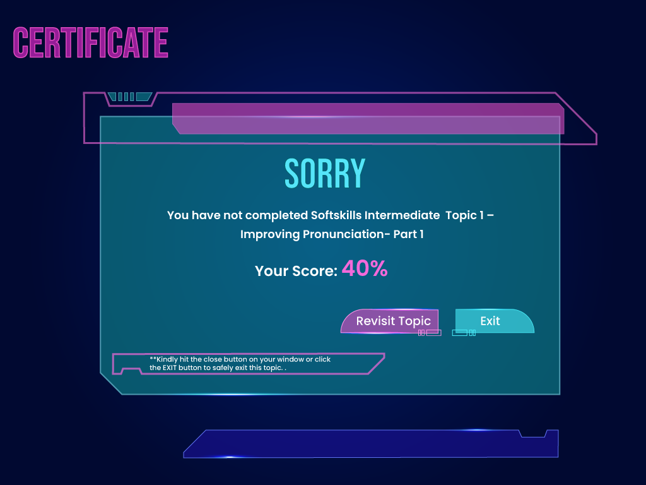

Notes:
Oh oh! Scored less? Not to worry. We recommend you to revisit this topic and retake all the questions to score better and complete it successfully. Good luck!​
You have not completed the
Topic 9: SQL Sub-queries in SQL Foundation Module
You have not completed FrontEnd Beginners Topic 14:
JSON - Objects
**We recommend you to revisit this topic and retake all the questions to score better and complete it successfully.
Notes:
Audio – for low score (less than 90%):
Oh oh! Scored less? Not to worry. We recommend you to revisit this topic and retake all the questions to score better and complete it successfully. Good luck!​
Developers Notes: The final assessment, the marks will reveal in the end as shown on the screen.
On every correct answer, learner will get marks.
GD notes: Need image similar to the image pace on screen, or just clean it, this image is free on the web.

